Slide 1
Community Meeting
Phase 1 of the Hometown Redevelopment Area
Proposed Redevelopment Plan
January 19, 2023

Slide 2
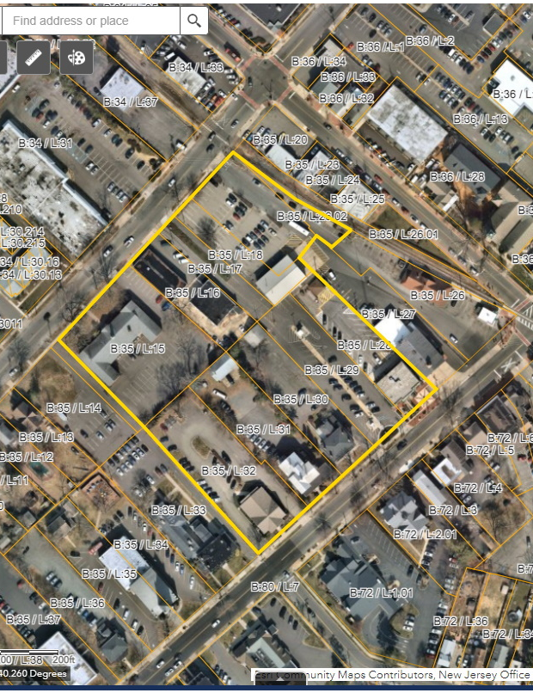
Redevelopment Area

Slide 3
Redevelopment Plan
Lays out a vision for the property
  Architecture
  Public Amenities
  Resident Amenities
  Allow flexibility with respect to standards to permit for creativity
Revitalization of stagnant conditions

Slide 4
Architecture
Materials and Design to compliment
Freehold Borough

Slide 5
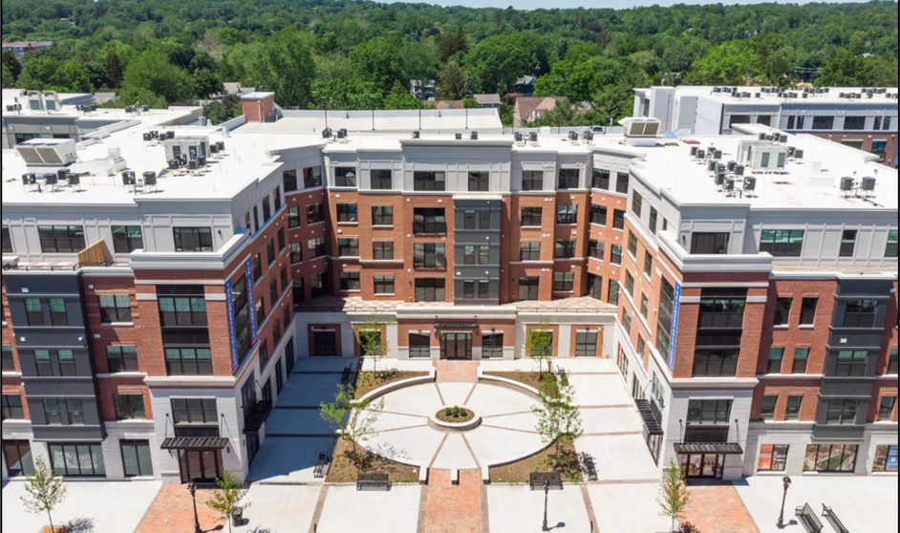
Architecture:
Step-Backs

Slide 6
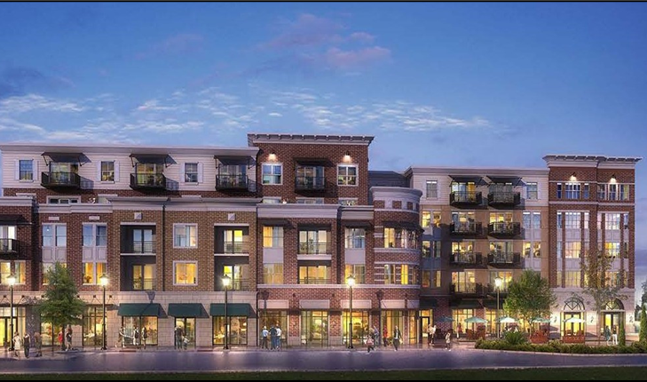
Architecture:
Step-Backs

Slide 7
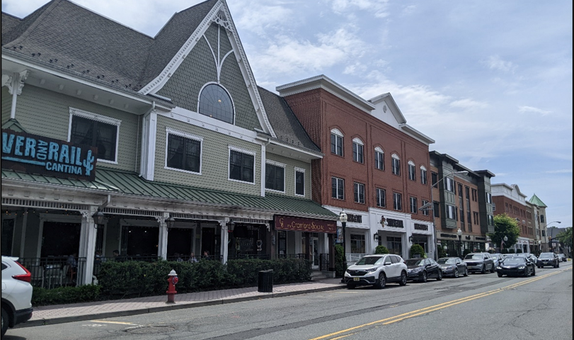
Architecture:
Façade Treatments

Slide 8
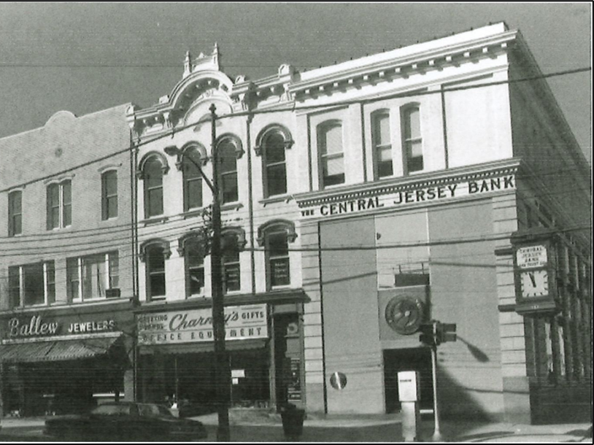
Architecture:
Roof Lines

Slide 9
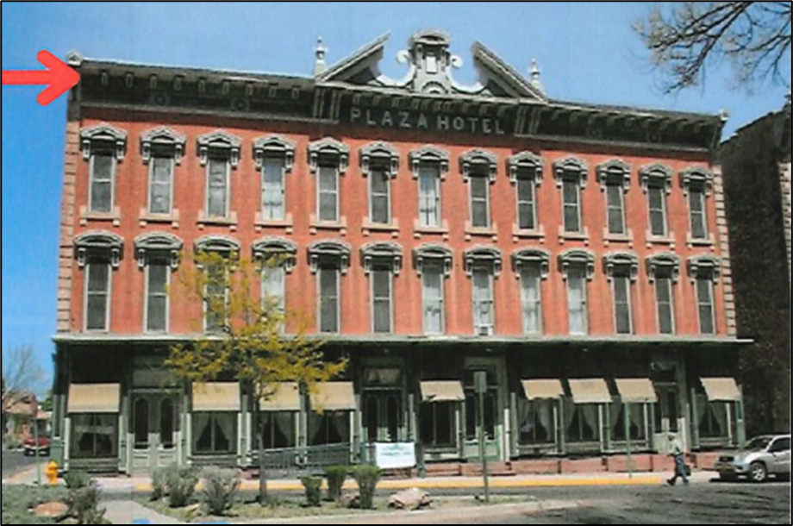
Architecture:
Roof Lines

Slide 10
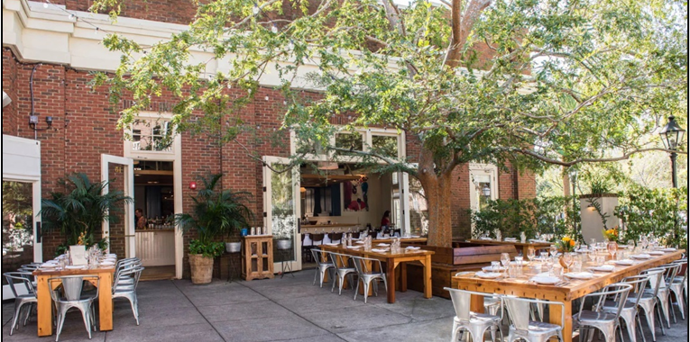
Required Public Amenities
A public courtyard is required containing at least 7,500 sq.ft.
Incentive to provide a shared parking facility for public and private use.

Slide 11
Resident Amenities
Focused to encourage young professionals, as well as the Borough’s empty nesters desirous of comfortable living within the Borough without the obligations of home maintenance.
  Game Room
  Golf Simulator
  Private Storage Locker
  Fitness Center
  Dog Walk/Washing Area
  Swimming Pool
  EV Friendly
  Secure package/grocery receiving

Slide 12
Project Assumptions
Up to 400 residential units
At 400 units, 60 would be set aside as affordable
Market Rate: 40% one-bedroom (136 units) & 60% two-bedroom (204 units)
Estimated Affordable Distribution: (12) one-bedroom, (36) two-bedroom, & (12) three-bedroom
Some units may be restricted to senior citizens

Slide 13
Demographics
Estimates obtained utilizing:
Who Lives in New Jersey Housing? Updated New Jersey Demographic Multipliers published by the Center for Urban Policy Research, November 2018 Listokin, et. al.
School- Age Children in Rental Units in New Jersey: Results from a Survey of Developers and Property Managers published by Rutgers Center for Real Estate: White Paper Series, July 2018

Slide 14
Population
Anticipated – 826 residents of different ages of which a portion are anticipated to come from within the community
Demographic Benefits
  Feet on the ground to support retail/restaurants
  Larger pool of potential volunteers
  Luxurious housing alternative for residents desirous of staying within the community.

Slide 15
School Children
Estimates of between 40 – 60 resident students, some of which are already within the community.
  Students will be distributed throughout the grade levels
  (K – 12).
  Borough schools have reported a decline in student population of approximately 54 students since the 2016-2017 school year.

Slide 16
Questions?

